Slide 1







CEF 440 : INTERNET & MOBILE PROGRAMMING
Task 2
REQUIREMENT
GATHERING
Date: April 22, 2025
Presenter: Group 1

Slide 2




AGENDA
AGENDA
Overview & Project Scope
01
Results from the survey
06
02
07
Functional Requirements
Data Gathering
Non Functional Requirements
03
Data Cleaning
08
Stakeholder Identification
04
User Reluctance and assesment
09
05
10
Requirement Gathering techniques
Conclusion and recommendations

Slide 3


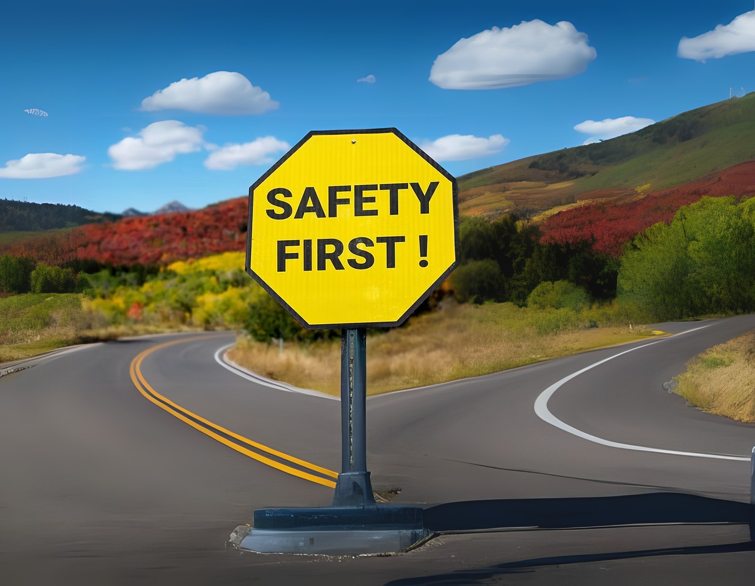
01
OVERVIEW & PROJECT SCOPE
Background
In a world where real-time information can significantly influence road safety and travel efficiency, designing a mobile application that addresses drivers' needs is more critical than ever.
Mission Statement
This project involves bridging the information gap drivers face concerning road signs and current road conditions by developing a mobile application to assist drivers in major Cameroonian cities (Buea, Limbe, Kumba, and Douala) in providing real-time road navigation support.

Slide 4



02-03
REQUIREMENTS
Requirements gathering is a systematic process of identifying, documenting, and analyzing the needs and expectations of stakeholders to ensure a proposed system effectively addresses user problems
01
FUNCTIONAL
REQUIREMENTS
02
NON-FUNCTIONAL REQUIREMENTS

Slide 5

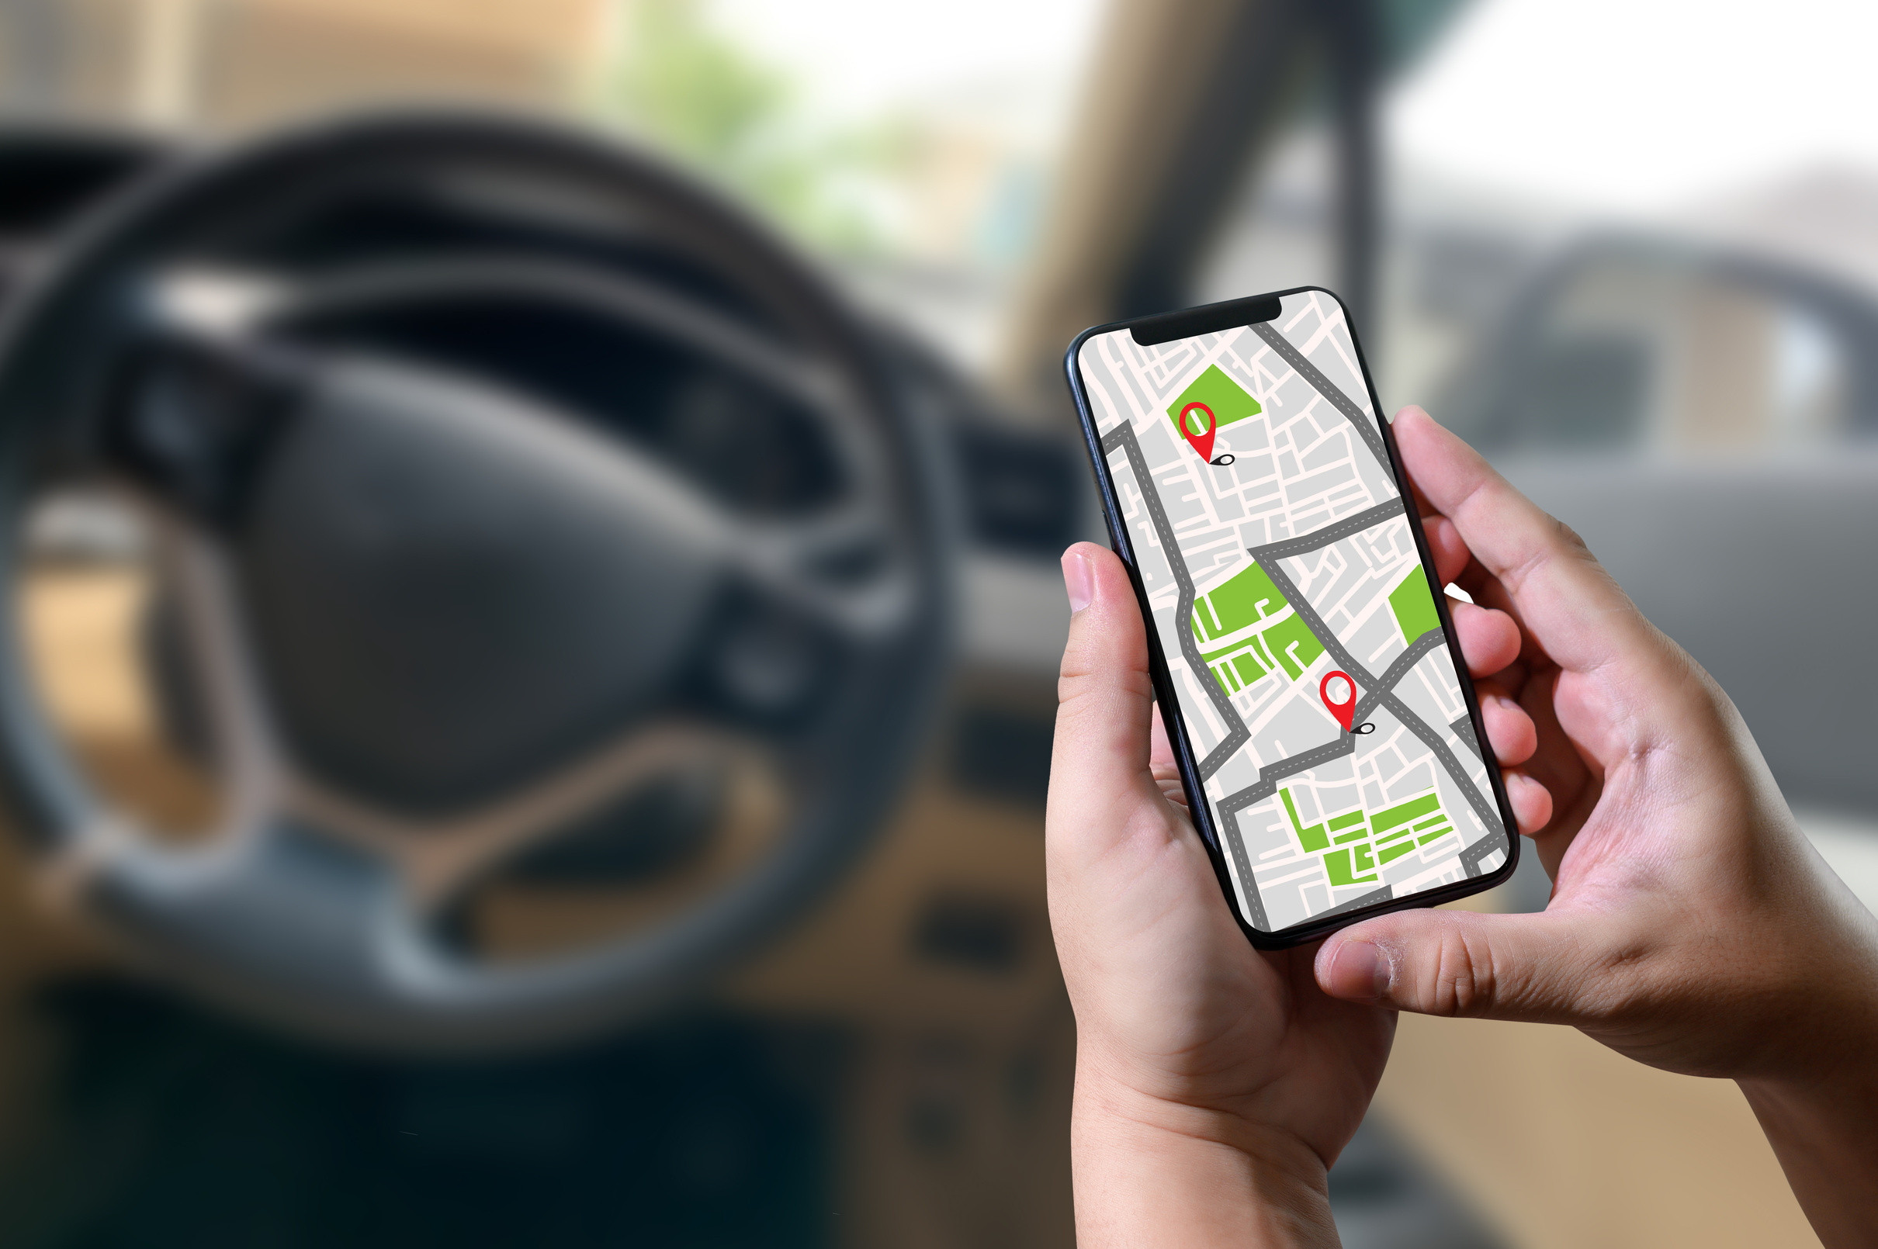
02
FUNCTIONAL REQUIREMENTS
Interactive road sign library
Real-time traffic condition updates
Integration with GPS
Data collection from user
Nearby Petrol stations notifications
User feedback mechanism

Slide 6
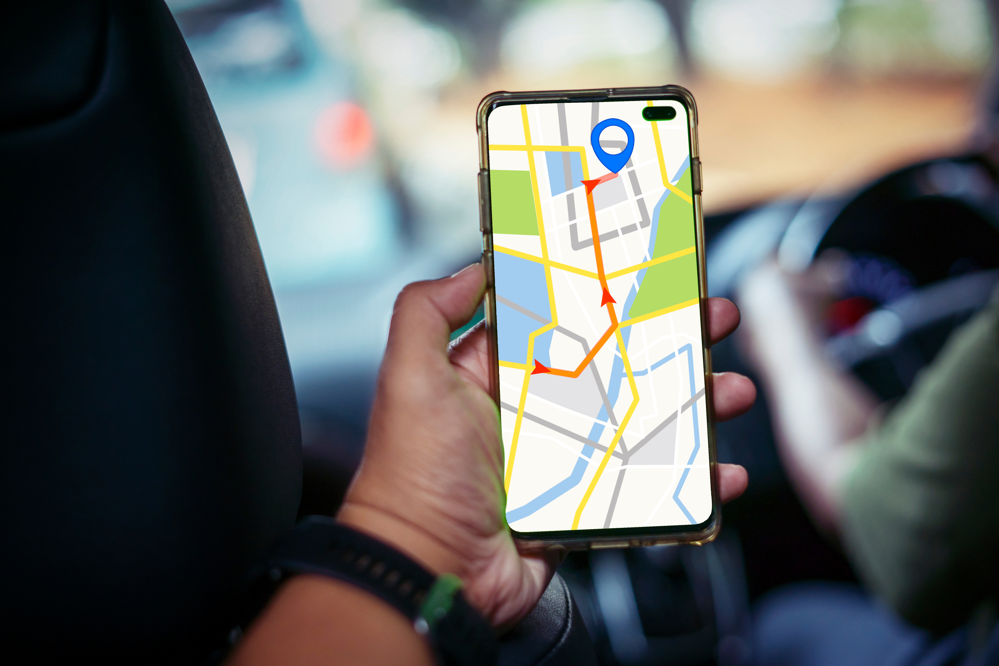
03
NON-FUNCTIONAL REQUIREMENTS
Usability
Performance
Scalability
Offline mode for basic navigation
French/English multilingual support
Robust data security for users’ information

Slide 7







04
STAKEHOLDER
IDENTIFICATION
App
Developers
Law
Enforcement
Traffic
Authorities
Municipal authorities
Drivers
Pedestrians
The primary users who need road sign meanings and real-time road condition updates.
They would benefit from the road signs, traffic lights library and become literate road users
Responsible for building and maintaining the mobile application
May provide updates on accidents, road closures, or emergencies
They would benefit from the road signs, traffic lights library and become literate road users
They are responsible for road maintenance can get informed of road conditions.

Slide 8









05
REQUIREMENT GATHERING TECHNIQUES
One on One Interviews
Reverse
Engineering
Traffic authorities
Driving School Tutors
Taxi drivers
Surveys
Analyzing existing navigation apps to learn from their strengths and weaknesses.
Simple online (Google forms) to ask users what features they want
Observation and Brainstorming
We observed traffic patterns and road conditions in high-traffic areas of Buea
we brainstormed during group sessions with sessions with team members

Slide 9






06
DATA GATHERING
3. User-Generated Data
2. Road State Data
1. User reports
2. User ratings
3. User feedback
4. Additional Data
1. Road surface condition
2. Traffic congestion
3. Road closure
4. Weather condition
5. Accident reports
1. GPS data
2. Sensor data: (e.g., accelerometers, gyroscopes) in users' devices
3. Third-party data: (e.g., traffic APIs, weather APIs)
Road Sign Data
1. Sign type
2. Sign location
3. Sign condition
4. Sign images

Slide 10









DATA CLEANING
07
Correct Inconsistent or Misspelled Entries
Remove Irrelevant data
Merge Similar Data Entries
STEP 1
STEP 2
STEP 3
STEP 4
STEP 5
STEP 6
Identify & Remove
Duplicates
Standardize Formats
Fix Missing or Incomplete Data

Slide 11
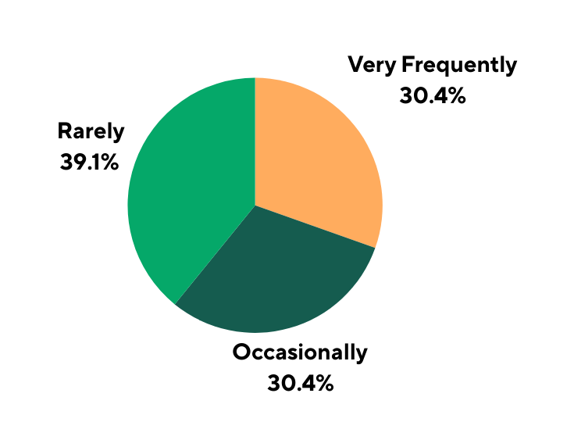
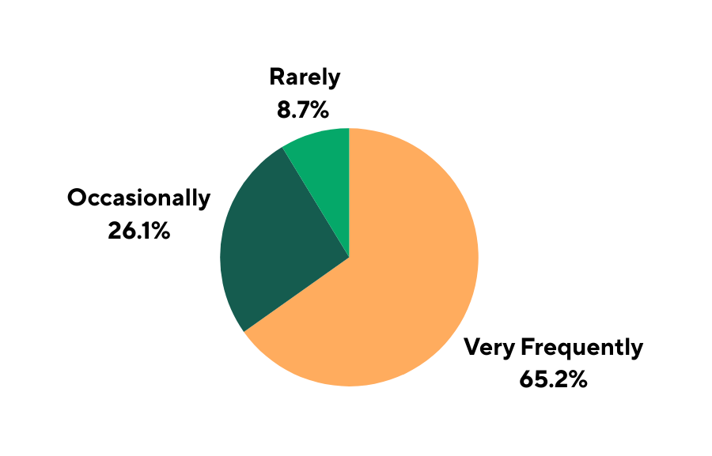

06
RESULTS FROM THE SURVEY (1/2)
People who uncovered unfamiliar Road signs
People who misunderstood Road signs
20%
10%
25%
30%
Very Frequently
Occasionally
Never

Slide 12
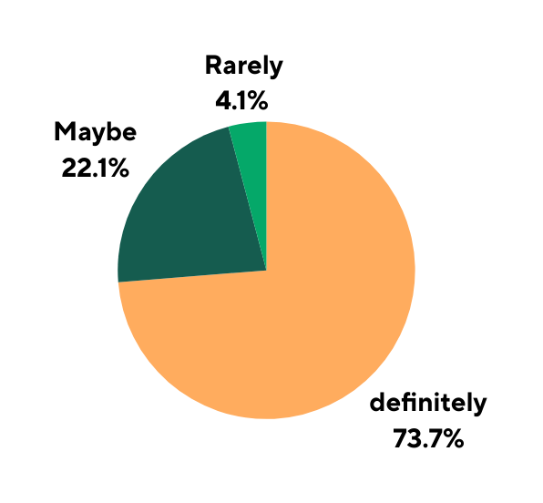
06
RESULTS FROM THE SURVEY (2/2)
Definitely
Maybe
Never
Would you use a mobile app that alerts you on road signs and updates you on real time road conditions?
20%
From the Survey conducted, over 73% of people gave their support on the need for an app that Solves this problem.
26% of them gave practical suggestions on how to build and improve the app
10%
25%
30%

Slide 13



09
USER RELUCTANCE
ASSESSMENT
No | Some Users may not want to use the app Because: | To Address this, we will
01 | They are not tech-savvy | Design a simple and user-friendly interface
02 | They worry about privacy, especially location tracking. | Ensure transparency in data use.
03 | They prefer traditional methods like road maps. | Offer customizable settings for notifications and data sharing
04 | Limited smartphone literacy among older drivers | Add tutorials and help features
05 | Concerns about mobile data costs | Partnership with telecoms for affordable data plans
06 | Skepticism about app accuracy | Gradual feature rollout to build trust

Slide 14




10
CONCLUSIONS & RECOMMENDATIONS
RECOMMENDATIONS
1. Develop a Minimum Viable Product (MVP)
2. Establish partnerships:
- Local authorities for official road data
-Telecom providers for affordable data access
- Road sign database
-Basic route navigation
-Critical alerts system
4. Implement continuous feedback mechanisms
3. Conduct phased rollouts:
- Initial launch in Douala as primary test market
-Gradual expansion to other cities based on feedback
-In-app reporting tools
- Regular user surveys

Slide 15

10
CONCLUSION
Summary
The process revealed strong demand for solutions addressing road sign confusion, poor road conditions, and lack of real-time traffic information.
Overwhelming 93% of road users are interest in the proposed application
Final Notes
The project's success hinges on maintaining close engagement with driver communities throughout development to ensure the solution remains aligned with evolving user needs and local road conditions

Slide 16
CEF 440 : INTERNET & MOBILE PROGRAMMING
Task 2
THANK YOU
Date: April 22, 2025
Presenter: Group 1

